Slide 1


A Visual Analysis of Laughter using the TV Sitcom Seinfeld
ULYSSES LIN
VINCENT MARKLYNN
ANJALI SEBASTIAN

Slide 2
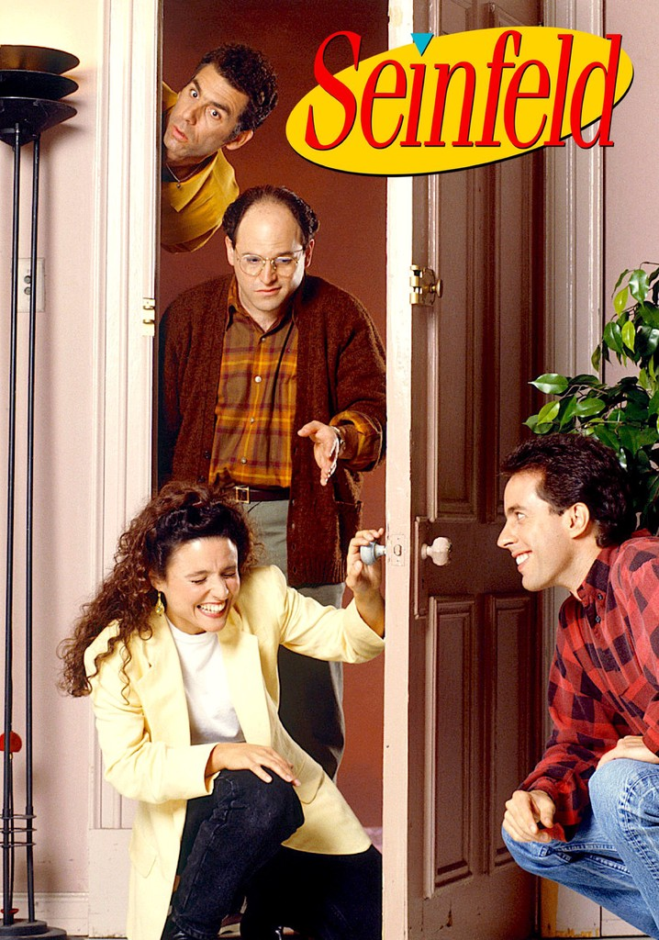


Motivation
Multi-camera sitcoms such as Seinfeld and Friends dominated the US sitcom production in the 1980s.
Multi-camera sitcoms are usually recorded in front of a live studio audience.
We want to analyze the amount of laughter that each main character receives from the audience and/or laugh tracks.
We want to create a fun and unique visualization on an interesting topic - "What makes us laugh?"

Slide 3
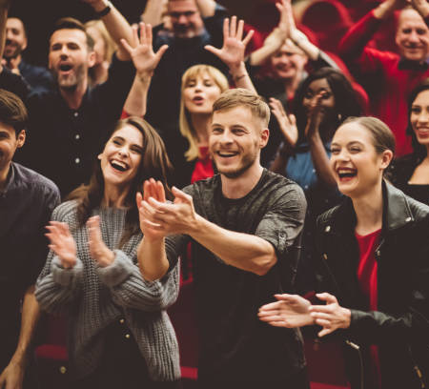
Audience
Sitcom Fans
All Seinfeld Fans
Anyone who is curious about
Laughter
Sitcom dialogue patterns

Slide 4
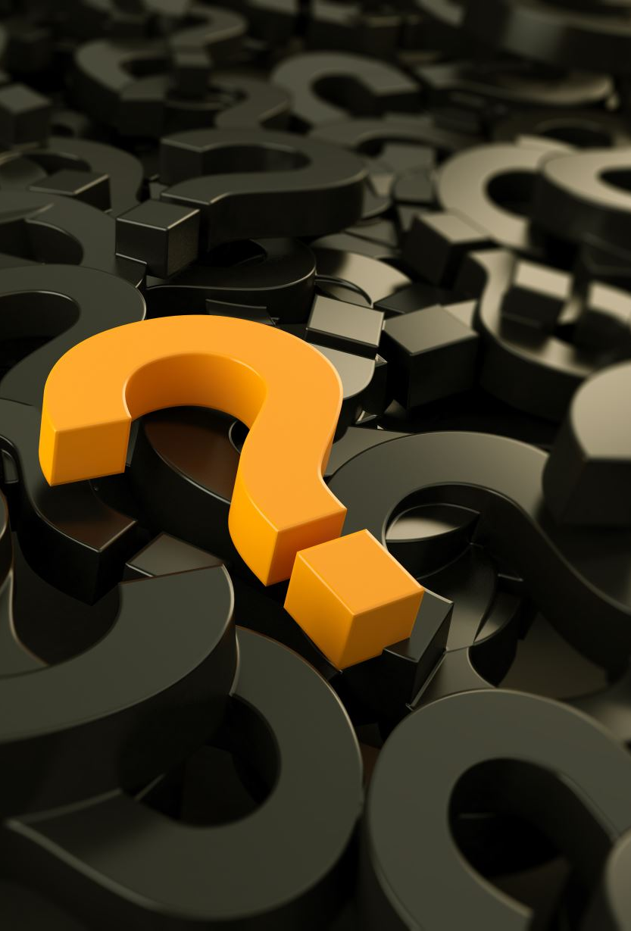
Main Questions
How often does laughter happen?
Which character gets the most on-screen time?
What does the dialogue sequence look like for segments with a lot of laughing?
Among the four main characters who gets the most laughs?
It is difficult to determine if certain character is responsible for a specific laugh
Instead, we can see which characters were present when a laugh sequence happened?

Slide 5
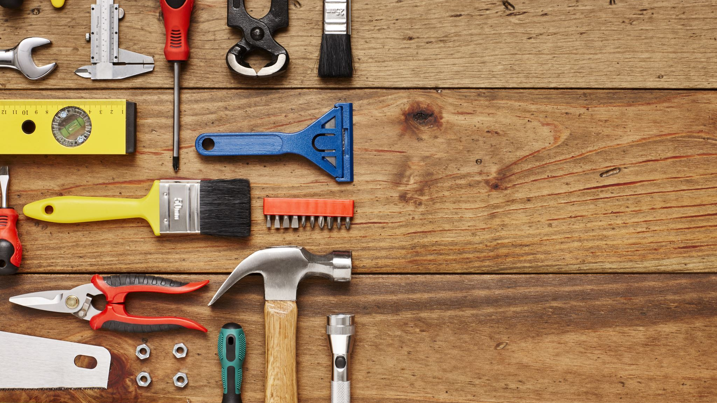
Tools
Adobe Color
Amazon S3
Amazon Transcribe
Bootstrap
D3.js
Python
aws-transcribe-transcript
Video JS

Slide 6
Data
Jerry
George
Kramer
Elaine
Seinfeld Episode – The Soup Nazi (s7e6)
Length: 22 mins 49 seconds
Granularity of data is 1 second
Manually mark laughter
Currently the transcriber is not able to detect laughter
Three levels of laughter 1,2,3 (most intense)
0 indicates no laughter
ML + subtitle to transcribe and identify speaker
Manually check quality
Format that is compatible with D3.js
Identifying a scene to group dialogue together
Manually mark scene start, end and description.
E.g., Jerry's Apartment, George and his soup

Slide 7
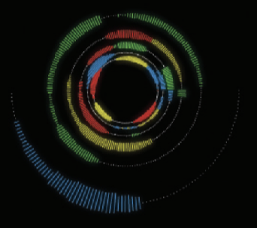
Related Work & Differences (1/2)
We visualize the entire episode as one ring segmented into scenes.
We visualize laughter along with the conversation
Each character is displayed as a separate color along a single donut (same thickness) ring.
There is no history of conversation and the white space in the ring is utilized for summary statistics and a mini video player
Selecting a segment generates a detailed view for the selected scene.
We were inspired by the "Conversation Clock"
Sitcoms like Seinfeld have few characters (four) and we wanted to visualize turn taking of dialogues.
"Conversation Clock" from the article "Social Mirrors as Social Signals: Transforming Audio into Graphics" - by Karahalios and Bergstrom.

Slide 8
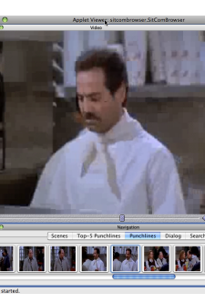
Related Work & Differences (2/2)
While looking if similar work has been done, we came across a paper by Friedland, Gottlieb, and Janin
The paper uses speech markers to identify punch lines and focuses on Machine Learning related to diarization.
The related work does not have a visualization that intersperses laughter and conversation.
We want our visualization to be more exploratory in nature where the user can visualize conversation threads and laughter together.
“Using Artistic Markers and Speaker Identification for Narrative -Theme Navigation of Seinfeld Episodes” by Friedland, Gottlieb, and Janin (2009).

Slide 9
DEMONSTRATION
LINK TO SERVER

Slide 10
Design Rationale 1/3
The donut-like graph is the foundation of the visualization
Clicking on specific scenes will trigger detailed information.
Scene line graph that displays characters speaking in the scene.
Video of the specific scene.
Intuitive interactions: e.g., clicking on specific scenes gives users a detailed view of the scene.
Dialogue Filters: allows viewers to filter dialogue based on speaker.
Horizontal lines in the line graph shows intensity of laughter.

Slide 11
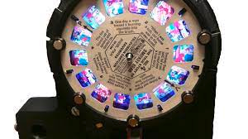
Design Rationale 2/3
Time is linear so why a circular visualization?
Better for seeing the big picture since it is more compact.
Easier to see the laughter rendered in parallel
Reminds one of a clock (think primetime hour)
Switch scenes like in view master or movie reel
Individual Scene is a linear visualization?
Circular visual has too much distortion.
Better detailed view: Linearity show the start and end of each dialogue clearly.
See the dialogue pattern on top of the laughter

Slide 12
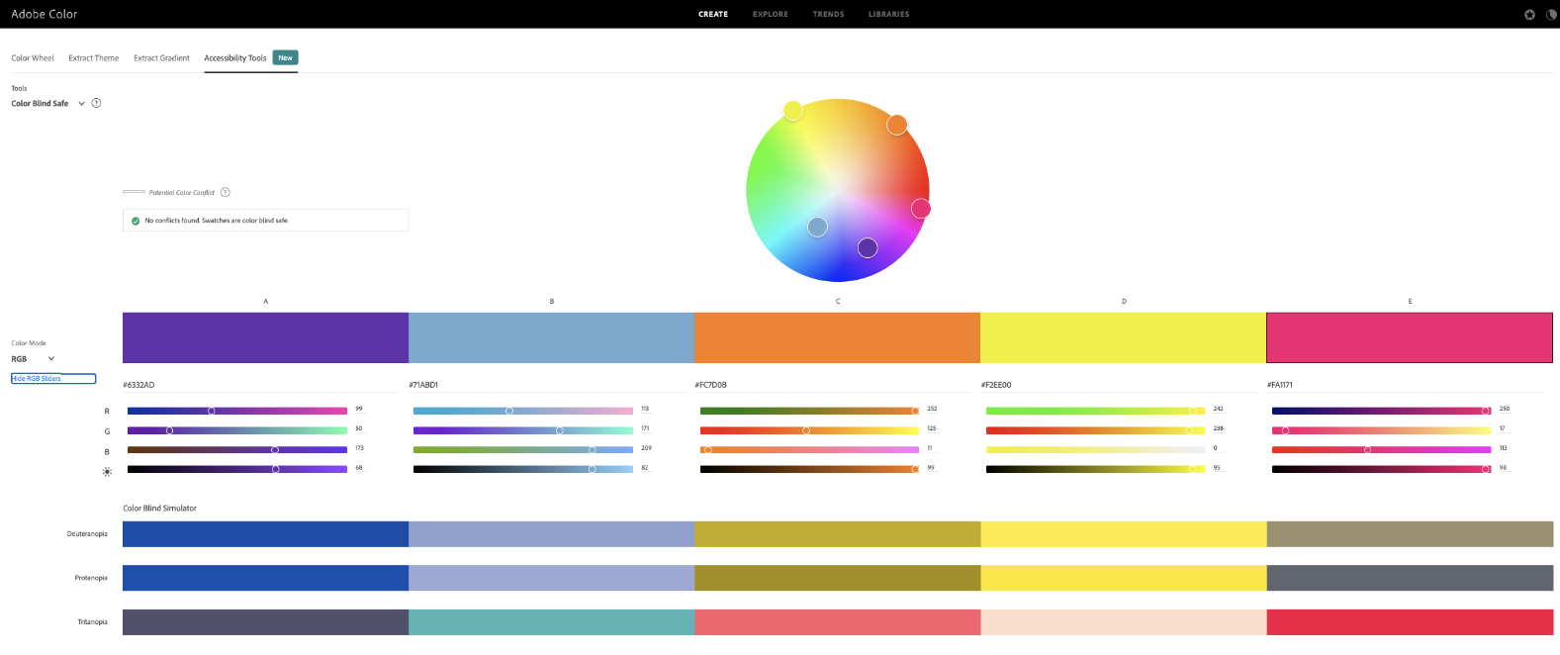
Design Rationale 3/3
Color Scheme:
Color scheme is accessible to viewers with various color vision deficiency such as deuteranopia, protanopia, and tritanopia.

Slide 13
Insights 1/2
Jerry has a head start due to the show’s standup cold open.
On-Screen Time Distribution
Jerry 26%, Elaine 23%, Other 22%, George 16%, Kramer 10%
Other characters are important to the storyline
9 scenes do not have Jerry (6,7,8,9,12,14,15,16, 20)
Laughter is distributed among the show’s four main casts.
This shows that Seinfeld’s comedy revolves around the dynamics of the characters; not just Jerry.
In this episode we see "The Soup Nazi" gets some very loud laughs

Slide 14
Insights 2/2
Laughter Patterns
Scenes tend to end with laughing which then is cut out with theme tune before the next scene starts.
The laughter ranges from low chuckles to raucous laughter with audience clapping.
Finding segments and scenes with heavy laughter
By looking at the laughter values in the circular visual we see that Scene 5: Crab Bisque is very funny.
We can see the dialogue patterns for the scene alternate between : Jerry – George and then Jerry – Kramer.
The scene ends with Kramer saying, "Yeah, but this is so nice and thick. Ahoy there!" , which gets a lot of laughs.

Slide 15

Future Work & Questions
Generalize the visualization to work with other episodes.
More automation to process the dialogues
ML to detect laughter
Include a chord diagram that shows character interactions.
Layout changes
We felt restricted by our current D3.js knowledge.

Slide 16

Information References
Amazon Transcribe https://docs.aws.amazon.com/transcribe/latest/dg/diarization.html
Open CV Basics
https://youtu.be/RqlQYBcsq54
D3 Resources
https://d3-graph-gallery.com/index.html
https://d3js.org/

